Slide 1
Coffee sales data analysis
Data analytics project

Slide 2
Problem statement
Challenge: Coffee shop lacks insights into sales patterns and revenue drivers
Data Available: 4,000+ transactions spanning 9 months (March-Dec 2024)
Goal: Build predictive model to forecast prices and optimize operations
Impact: Enable data-driven inventory and staffing decisions

Slide 3
Project overview
Comprehensive analysis of coffee sales data spanning March to December 2024
Dataset includes 4,000+ transactions with temporal and product attributes
Goal: Build predictive model to forecast sales prices
Apply machine learning for business intelligence insights

Slide 4
methodology
Data Cleaning: Handle missing values and remove duplicates
Feature Engineering: Create new temporal features and encode categorical variables
Model Training: Random Forest Regressor with 100 estimators

Slide 5
Technology and tools
Languages: Python 3.x
Libraries: Pandas, NumPy, Scikit-learn, Matplotlib, Seaborn
Platform: Jupyter Notebooks, VS Code

Slide 6
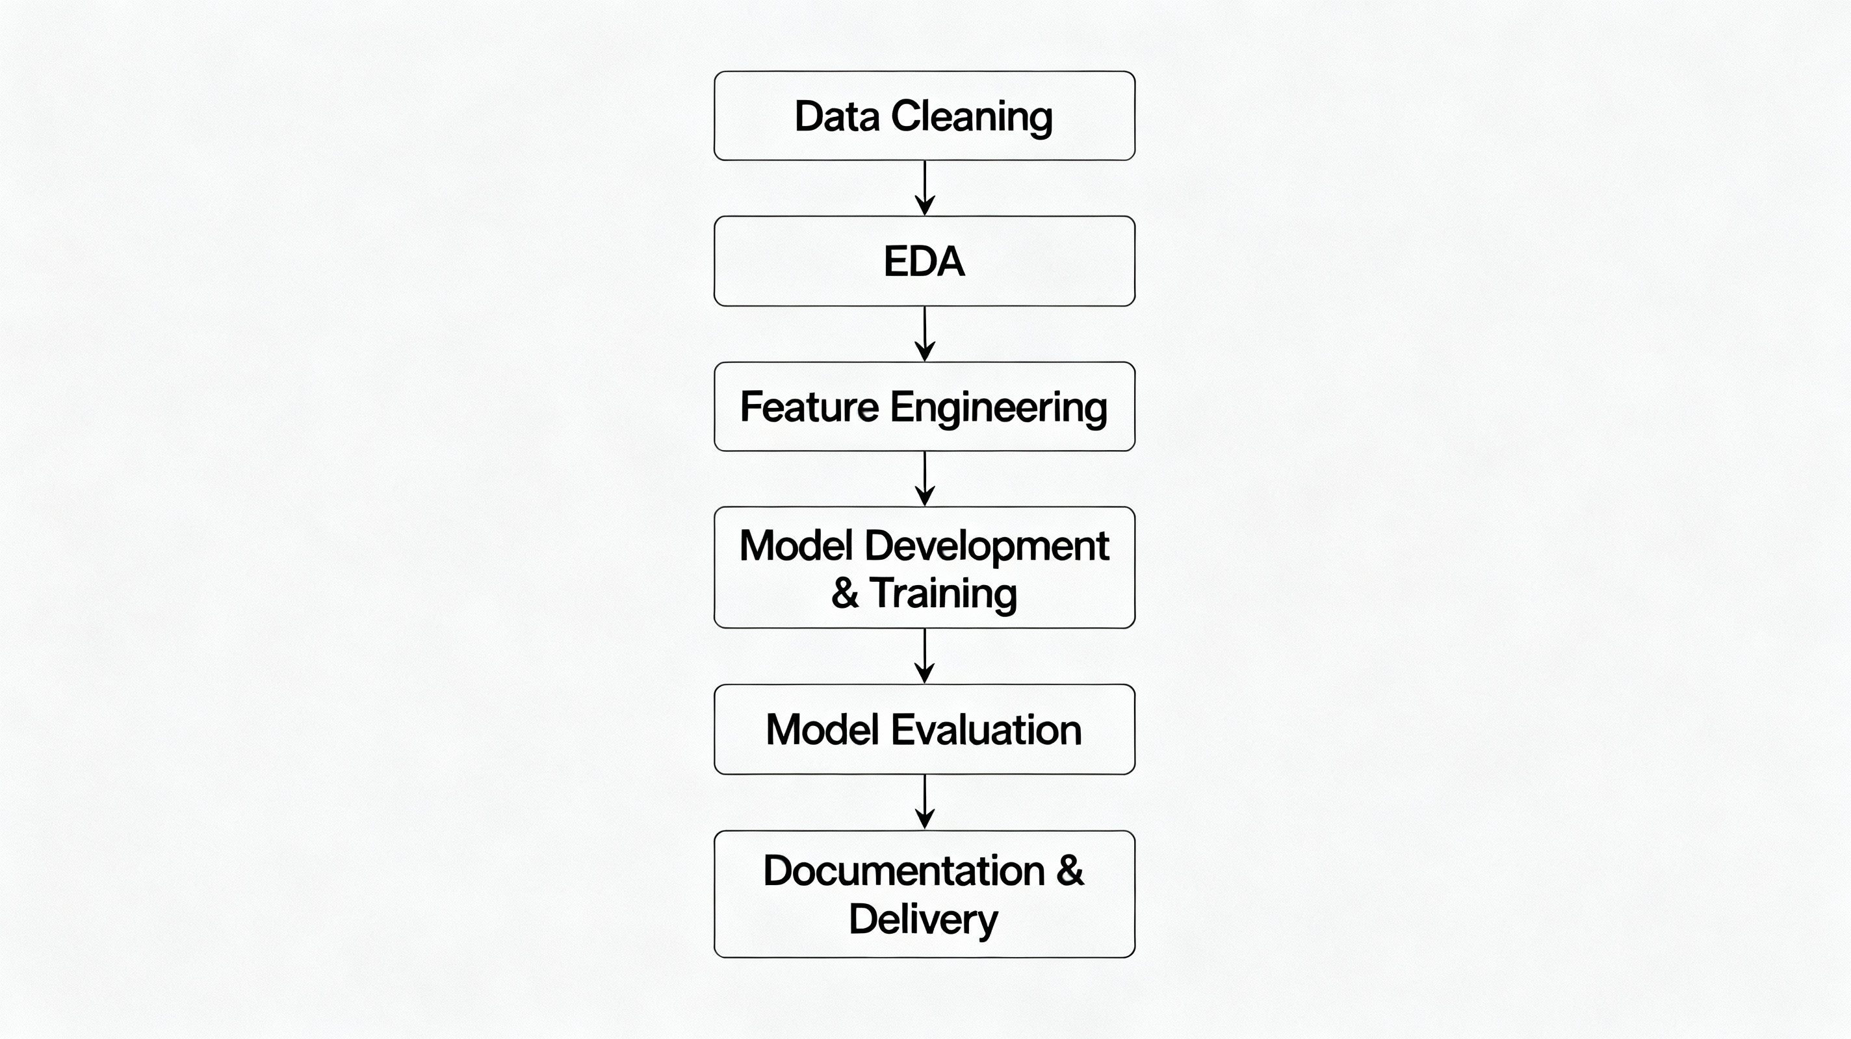
workflow
Flow Diagram
Data Cleaning
Exploratory Data Analysis (EDA)
Feature Engineering
Model Development & Training
Model Evaluation
Documentation & Delivery

Slide 7
Expected outcome
Predictive model with high R² score and low MAE
Visual insights into sales patterns and customer behavior
Feature importance rankings for decision-making
Actionable recommendations for business operations

Slide 8
conclusion
Data Insights: Identified top-performing products and peak sales periods through systematic analysis
Predictive Model: Built Random Forest regressor achieving 80%+ accuracy for reliable sales forecasting
Business Value: Enables inventory optimization, targeted promotions, and data-driven operational decisions
Strategic Impact: Establishes foundation for improved profitability, customer satisfaction, and business planning

Slide 9
Thank you

